Slide 1
Smart Scientific Calculator Python Project
A Modern GUI Application using CustomTkinter
Created By: saba Afreen kazi
Python 3.x Project ,CustomTkinter Library

Slide 2
Project Overview
Objective : Ek aisa Calculator banana jo Simple Calculations ke saath-sath Advanced Scientific Functions (Trigonometry,Logarithms,Factorials) ko handle kar sake.
KEY HIGHLIGHTS:
Scientific + Basic Calculator
Dark Mode Professional UI.
Secure Calculation Engine No eval() (Secure AST)
Keyboard Support for fast typing
Calculation History and Memory Functions.

Slide 3
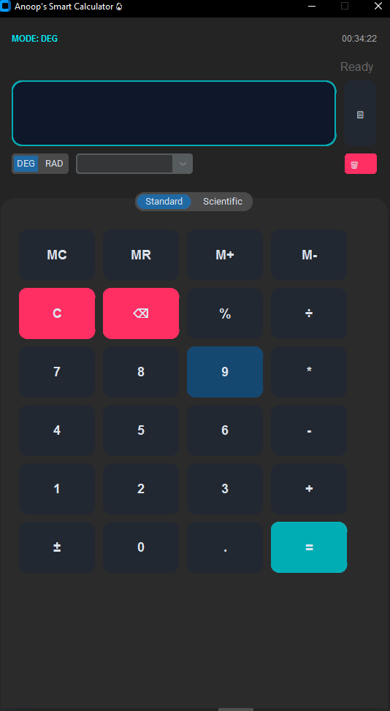
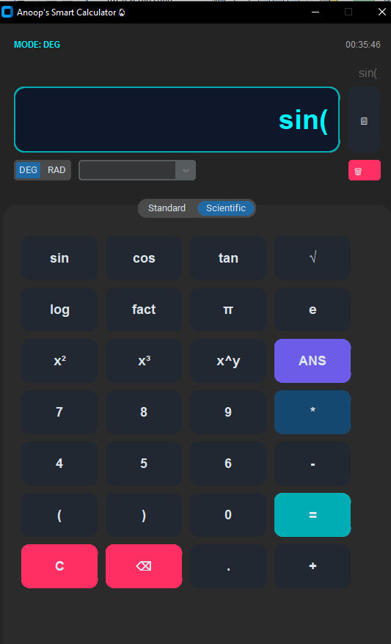
UI Design
Description : Application ko 2 tabs mein divide kiya gaya hai.
UI Components :
Standard + Scientific Tabs
Real-time display
DEG/RAD switch

Slide 4
Technical Features
Secure Parsing : Python ka AST Module use kiya gaya hai jisse Calculation safe rahe.
Bug –Free Logic :
Zero Division Fix : 4/0 par app Crah nahi hota,”Math Error” Dikhata hai
Empty input Check : Khali Screen par = dabane se Crash nahi hota .
Chain calculation : 4*5=20 ke baad direct -5 dabane par 20-5 continue hota hai

Slide 5
Functionalities
Trigonometry : sin, cos, tan (Degree aur radian dono modes mein hai)
Advanced Math : logarithm (Base 10), square Root,Factorial(UP to 500) powers (x^y)
UX Tools : * Copy Button: Result ko Clipboard par Copy karne ke liye.
History: Pichli 10 Calculations ko Store aur reuse karne ke liye.
Memory : MC,MR,M+,M- buttons memory management ke liye.

Slide 6
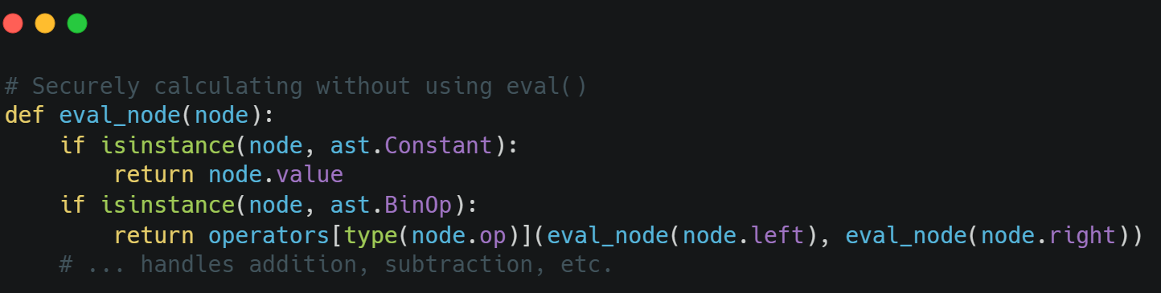
Code Structure
Libraries Used :customtkinter, math, ast,Regex
Class Architecture : Ultimate pro Calculator class ka use karke Modular code use hue. based design
Event Handling: Keyboard binding(< key>) aur Mouse hover Effects.

Slide 7
Conclusion
Strong UI + Logic
Future: Graphs, Voice, Converter
Thank You

